Slide 1

CPE 490 Embedded Systems Lecture 24
Exam 2 review

Slide 2
Choice
Have test Thursday, homework due on Friday.
Have homework due on Wednesday 5PM, then solutions given to study for Thursday exam
Move exam to Tuesday, publish Homework solutions Friday. (regular lecture Thursday)

Slide 3
ADC setup
Is in the lab you should just have to plug the card into your explorer 16 board.
Oscilloscope is right next to the setup in case you want to see what you should be getting.

Slide 4
Exam 2
Test is open book open note. (Remember you will not have the internet)
Format – T/F, explain, solve problem read code, write code.
Lectures – 12 through 24.
Concepts learned in lab are fair game.
Homework 4-5

Slide 5
Problem with Unsigned Numbers
int c;
char e=100,d=150;
c =e*d;
What is c? Not 100 * 150 = 15,000
But = -10600 ! How
char is a signed type so 150 => 150 – 256 = -106
Notes:
Remember two’s compliment is 2^N – X where X is number you desire to make negative. So if X= 1 then twos compliment is 65535 to represent -1. If you want to represent -32768 then 32768 would be used.

Slide 6
Problem with Overflow
long c;
int e= 30000,d=2;
c =e*d;
Answer = 60000?
Wrong answer = -5536
Math is done int * int. 60,000 is recognized as a negative number 2^16 – 60,000 = 5536 so it is recognized as a negative number.

Slide 7
Passing by Value in a Function
Type conversion is done if you use a different type to pass into a function then the one that it calls.
Again trouble if the target to be converted into can not be done.

Slide 8
Void Pointers
A void pointer is a pointer to data that is of a yet to be determined data type
It can be cast to point to any data object you would like .
It is useful in passing parameters of different variable types into a function

Slide 9
Example of Void Pointer in Function
void funct(void *a, int z) { if(z==1) printf("%d",*(int*)a); // If user inputs 1, then he means the data is an integer and type casting is done accordingly. else if(z==2) printf("%c",*(char*)a); // Typecasting for character pointer. else if(z==3) printf("%f",*(float*)a); // Typecasting for float pointer }

Slide 10
Pointer to Functions
Since a function is located at an address in program memory you can construct a pointer to the function
This feature allows you to pass a function into a function based upon need. It also lets you assign a function based upon say an input and then forevermore use that function once the input has been determined

Slide 11
Example of Using a Function Pointer
int DoIt (float a, char b, char c)
{ return a+b+c; }
int DoMore(float a, char b, char c)
{ return a-b+c; }
int main(void) {
int (*pt2Function)(float, char, char) = 0;
int d; char a =2,b=1,c=0;
pt2Function = DoIt; // short form
d = (*pt2Function)(a,b,c); //calling the function using a pointer
pt2Function = &DoMore; // correct assignment using address //operator
d = (*pt2Function)(a,b,c);

Slide 12
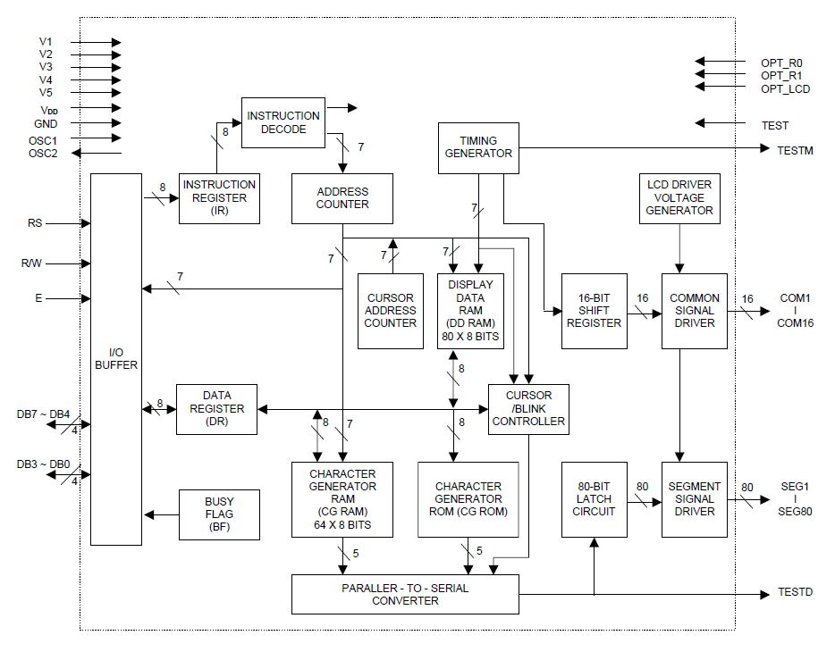
LCD Controller Block Diagram
Notes:
Notice interface is parallel

Slide 13
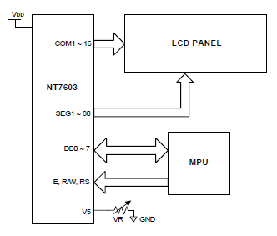
LCD Controller
The commands and displays are sent to the controller through a parallel interface. The controller output goes to the LCD itself.

Slide 14
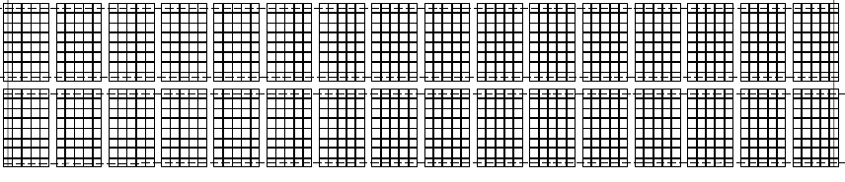
LCD Display Data Ram (DDR)
One to one correspondence to an address location in DDR to what is written on the LCD as shown
00
01
0F
40
41
4F

Slide 15
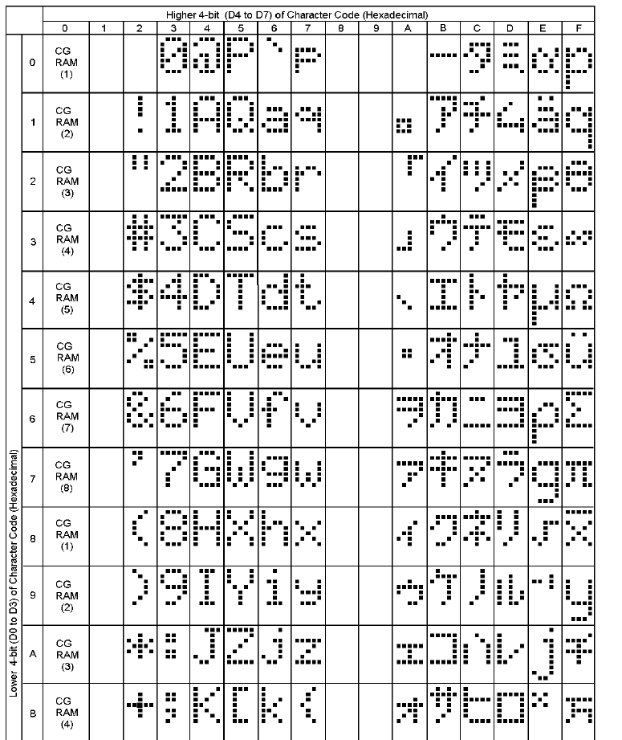
Character Generator ROM
Notes:
The Data Display Ram will have codes that represent characters, the code to character table is shown, and is in the data sheet. Column 0 will get character data from CGR. The columns 2-7 are the same as the ASCII code but with extension to include characters in columns B trough F.
For example J has a code of 4A

Slide 16
LCD Character Generator RAM (CGR)
CGR allows you to define your own bit pattern for a character cell. Your can store up to 8 characters of custom graphics.
There are 64 addresses (0x40-0x7F) each address describes one row of the character. Address 0x40 is the top row of the first character and 0x47 will be the bottom most row of the first character. Address 0x48 will start the top row of character 2 and so on.
Writing the code 0-8 in DDR will display one of the 8 CGR defined characters.

Slide 17
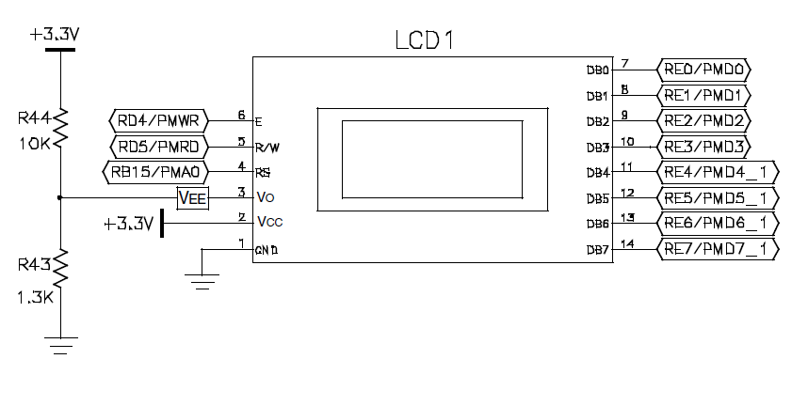

dsPIC33 Connection to LCD Controller
Notes:
The parallel interface consists of control bits and data bus bits.
The 3 control bits are described. The 8 data bits are the lower byte of the RE port. There is an option to use only a 4 bit data bus if you are using a smaller processor. The data bus is by directional beside the dsPIC writing data and command, you can also get information from the LCD controller so now the dsPIC pins need by inputs instead of outputs. In the PIC 24 series there is a built in interface bus for the LCD called a PMP or Parallel Master Port

Slide 18
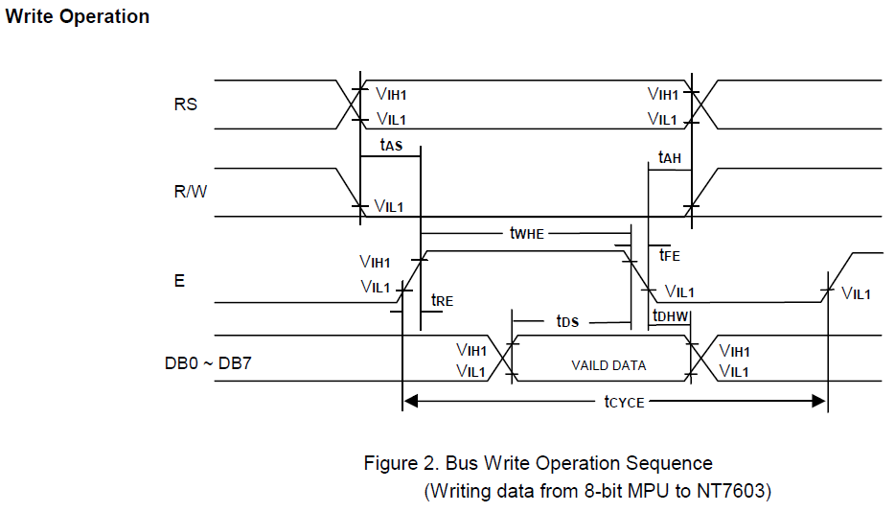
Write Cycle (Command or Data)
Notes:
t_{RE} and t_{FE} are the rise and fall times maximums they can be no longer than 25 ns.
tas is the RS and R/W setup time and a minimum of 60 ns is needed.
twhe is the minimum time that enable must be true it is 300 ns.
tds is the data setup time at a minimum it must be 150 ns
Tdhw is the data hold time and it must be at least 10 ns.
Tah is the hold time for RS and R/W it must at least 10ns
Tcycle is the minimum cycle time for a write that is 500 ns

Slide 19
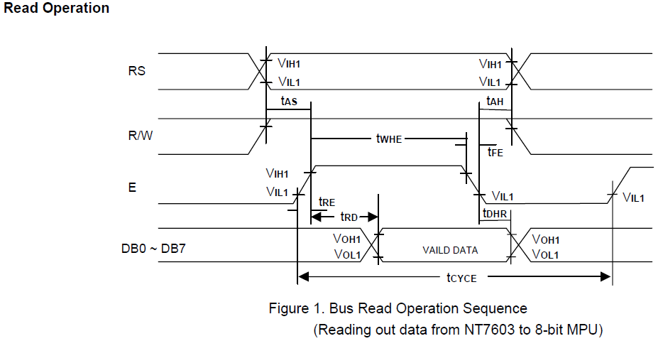
Read Cycle
Notes:
RS = high for data register read RS= low for busy flag read
t_{RE} and t_{FE} are the rise and fall times maximums they can be no longer than 25 ns.
tasa is the RS and R/W setup time and a minimum of 60 ns is needed.
twhe is the minimum time that enable must be true it is 300 ns.
trd is read data output delay and it a maximum of 190ns
Tdhr is the data hold time and it will be at a minimum of 20 ns.
Tah is the hold time for RS and R/W it must at least 10ns
Tcycle is a minimum of 500 ns.

Slide 20
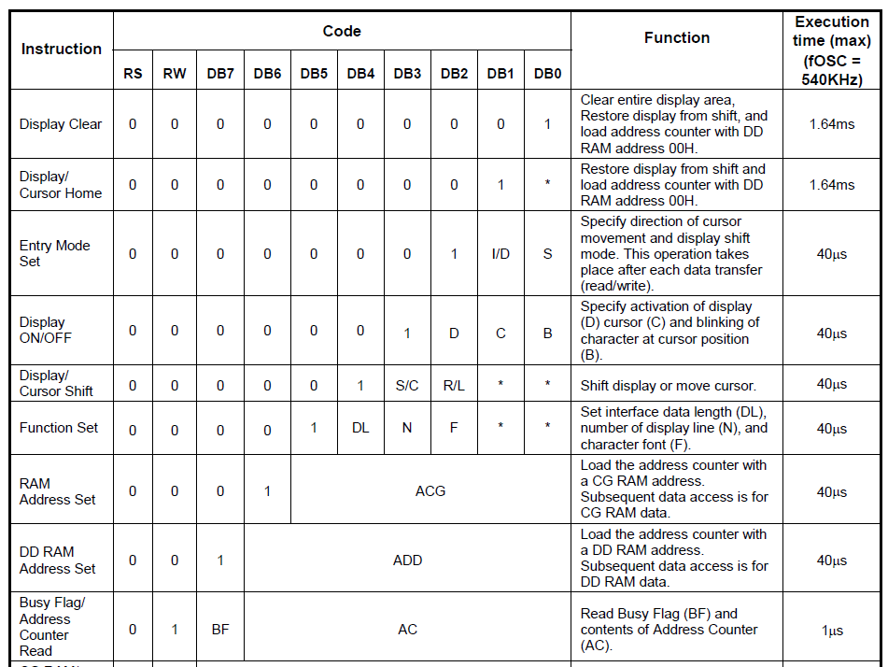
LCD Commands (dsPIC -> LCD)
Notes:
Refer to Novatek data sheet page 14 for full meaning of commands
Notice you can set up CGRAM address, if you do any data read or write will then be in CGRAM
Notice execution times what is the best way to ensure you wait long enough before sending another command?

Slide 21
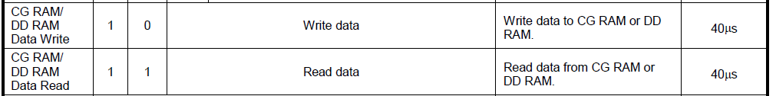
LCD Data Writes (DDR or CGR)

Slide 22
Motivation for Real Time Operating System (RTOS)
Basic problem: one microprocessor many things to do.
I can only do one thing at a time so how do I get many things done at once.
The things I must do have different levels of importance based upon
Importance to mission
Deadlines of when the job must be finished
Notes:
Think of a phone ringing I might have to answer it within 5 rings an definite deadline. But, mailing a letter might be of lower urgency because the postman does not come for 3 hours.

Slide 23
Definitions
Task – Is a single program process, strand, or section. It has a clear and distinct purpose and outcome. It is independent of other tasks, and it can’t call other tasks.
Multi-tasking – Many tasks performed ideally simultaneously.
Task Priorities – Task have priority, that is relative to the other tasks. Higher priority tasks run before lower priority tasks.
Deadline – when the task must be done, this can be based upon times or events.
Notes:
Deadline like you must answer the phone in so many rings (a time restriction). You must get the kids out the door before the bus comes (and event)

Slide 24
Real Time
So what does it mean to operate in “Real Time” (in contrast to false time?)
A system operating in real time must be able to provide the correct results at the required time deadlines.

Slide 25
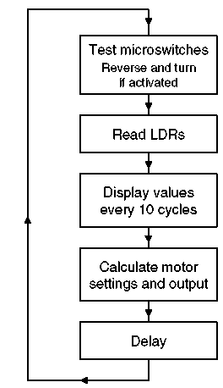
Priority and Deadline Example
Task | Priority | Deadline (ms)
Respond to microswitches | 1 | 20
Read LDRs | 2 | 50
Calculate and set motor speed | 2 | 50
Display | 3 | 500
Deadlines can be difficult and subjective to set.

Slide 26
Problems with Super Loop Approach
Loop execution time is not constant.
Tasks interfere with each other.
High priority tasks don’t get the attention they need.
Notes:
Loop execution time is not contant: Since each task will have conditional code (if then ) execution time must vary. Even though the overall loop execution can be kept constant with a delay it the delay is dynamic.
Tasks interfere with each other: As a result of uneven time execution one task can interfere with another. For example the 10th time through motor changes to sensors is going to come later than the loop before.
Priority does not matter: What would happen if the a limit switch gets activated just after reading the micro switches, it is a long time until this code runs again

Slide 27
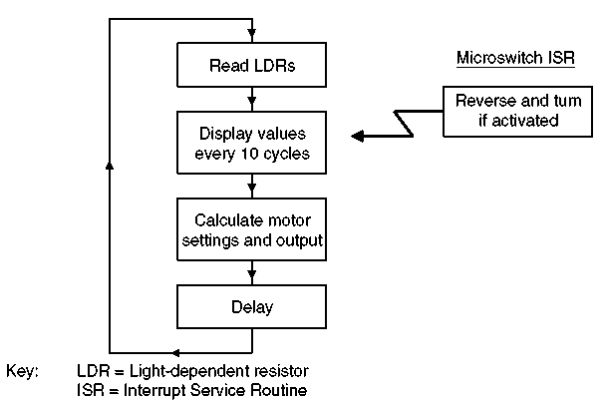
Using Interrupts for Prioritization – the Foreground/Background Structure
High priority event triggered tasks can be brought to the foreground by using an interrupt
The background events are usually time based interrupts and can use the repetition of the rate of the loop.
Notes:
We can see the deadline for reacting to the micro switch is and event driven.
While the updating of the display is a time based event.

Slide 28
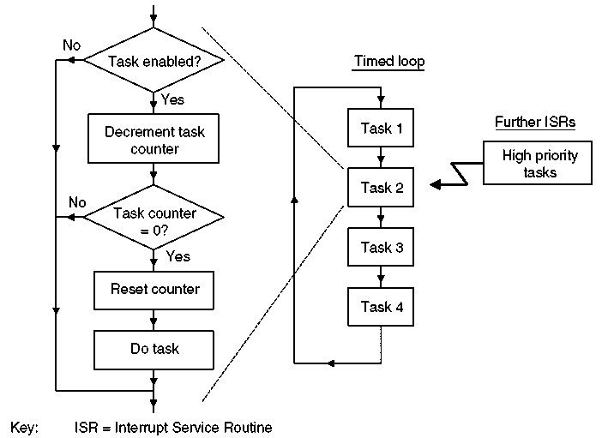
Refining Loop Based Timing Execution
Each task will have an enable flag
Each task can execute on a multiple of loop executions
Notes:
Still only two priorities either your in the interrupt structure or in the timing loop
Timing loop tasks still must wait for other tasks to end before execution can occur.
The tasks must cooperate with each other, if a task would hog the processor there is limited mechanisms to ensure ‘fairness’.

Slide 29
Real Time Operating System
Operating System (OS): a layer of SW that provides low level services and management of tasks or applications. This management consists of: scheduling the tasks, managing the context of the tasks, provide communication and synchronization between tasks and sharing and allocating system resources (e.g. peripherals) between the tasks.
RTOS: an OS that allows one to specify constraints on the rate of process, that guarantees that these rate constraints will be met.

Slide 30
Why RTOS?
Abstracting away timing information: Each task will have a simple API interface to the kernel (the core component of the OS) which will take care of the timing issues.
Maintainability / Extensibility : abstracting the timing information means that tasks are not interrelated. This means that it is easier to change an application without effecting others and easier to add tasks.
Notes:
Point 1: Typically you configure the RTOS for the Time Tick period but all the details are handled by the RTOS.
Point 2: In a super loop the order of task execution is set by the programmer by the order in the kernel. In the RTOS we don’t worry about that we only worry about setting priority levels.

Slide 31
Why RTOS?
Modularity: Since the tasks are not dependent on each other they can be modular only doing one well defined purpose. This leads to:
Easier team development
Easier testing
Code reuse
Notes:
Limited knowledge is needed about other tasks to develop a specific task.

Slide 32
Why RTOS?
Improved Efficiency – With an RTOS you never have to wait around for an event using polling techniques e.g. while (check_busy) {}. You can use either:
Interrupts on the events or
Periodic calls to check on conditions (polling but in a controlled way that is efficient)
Counter to the efficiency is that RTOS take up resources when they switch from one task to another.
Notes:
Point 1: even if you the task must wait for an external event to happen, if it has not happened it can release the CPU to the kernel when this occurs.
Point 2: In general there is a trade off between the time specificity and efficiency of the code.

Slide 33
Why RTOS?
Idle time: an idle task is created by default in a RTOS. This task can measure the amount of idle time while keeping all other tasks serviced. The amount of idle time is a measure of the utilization of the processor.
Flexible interrupt handling: ISRs can be very short because most of the code is deferred to handler tasks.
Notes:
Flags set in interrupts can be used to push a task to the ready state.

Slide 34
Why RTOS?
Mixed processing requirement: periodic, continuous, an event-driven processing within an application can all be taken care of . In addition the RTOS will let you set priorities for both soft and hard time requirements
Easier control and sharing of peripherals amongst tasks.

Slide 35
Scheduling Terms
Scheduler: Part of the kernel that decides which task should execute, when, and for how long. The scheduler can start and stop a task numerous times before the task finishes.
Scheduler Policy: The algorithm in the scheduler that is used to “fairly” divide processor time between tasks.
Notes:
Note scheduler in a corporative OS can not stop a task only start it.

Slide 36
Types of Schedulers
Preemptive – The scheduler can stop a task before it completes and give the processor to another task
Cooperative (non preemptive) – Scheduler can start a task but it can not interrupt it. The Scheduler must wait until a task completes in order to give the processor to another task.

Slide 37
Why Cooperative Policy
Cooperative is the antithesis of preemptive why do it?
Context savings is not needed
Less RAM needed
Many small 8 bit microprocessors do not have much RAM (16F84A has 68 bytes!)
BUT cooperative scheduling is not as responsive as preemptive scheduling.
Salvo is cooperative

Slide 38
Context related Terms
Context of a Task: All the information needed to be restored so that a task can be restarted this includes:
Program Counter
Status Register
Working Registers
Stack Pointers values
Context Switching: The action of saving the context of one task and restoring the context of another task.
Latency: The time it takes to do context switching

Slide 39
RTOS Tick
The RTOS kernel needs to know time in order to allow some tasks to sleep and one task to have a time slice for a certain duration.
A timer is setup with an ISR to keep track of time.
The ISR will increment a counter, the tick variable, so time between events can be tracked.
A task executing can be interrupted by the timer and then preempted if needed.

Slide 40
Task State
Running
Ready
Blocked
Suspended
At any instance only one Task can be running
All other tasks are either ready to run, blocked, or suspended
Notes:
Other names used for task states:
Ready or eligible
Blocked, waiting or delayed
Suspended, stopped, or dorment

Slide 41
Type of Tasks
Idle task – runs at the lowest priority, when no other tasks are ready
Event Driven task – Most of the time in the blocked state waiting for an event to occur. Can be high or low priority
High limits switch is true
Low button is being pressed

Slide 42
Type of Tasks
Periodic task – needs to run and complete in a certain period.
Continuous processing task – never block or suspend themselves.
Limited usefulness because they can only be created at the lowest priority.
Notes:
If a continuous task runs at any other priority than the lowest will starve all tasks of a lower priority

Slide 43
State Transition of Tasks
Notes:
What would cause going into the blocked state? – waiting for and event like a button push or a limit switch activation or waiting for a time event (certain amount of time passing) to occur.
Suspended tasks are not available to the scheduler. They enter that state by an API call and then active or exit also by an API call.
Tasks can be created and destroyed at will by other tasks.

Slide 44
Blocked State
Entered waiting for a synchronization event
External event like sensor activation
Internal event like completion of another tasks analysis
Waiting for a peripheral that is being used by another task.
Entered waiting for a temporal event
A delay period expiring
An absolute time being reached

Slide 45
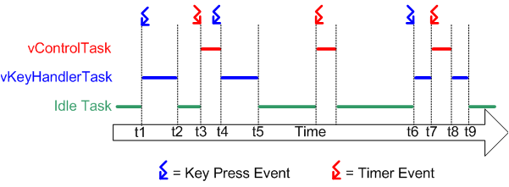
RTOS Preemptive Scheduling Example
Notes:
Referring to the diagram above:
At the start neither of our two tasks are able to run - vControlTask is waiting for the correct time to start a new control cycle and vKeyHandlerTask is waiting for a key to be pressed. Processor time is given to the RTOS idle task.
At time t1, a key press occurs. vKeyHandlerTask is now able to execute - it has a higher priority than the RTOS idle task so is given processor time.
At time t2 vKeyHandlerTask has completed processing the key and updating the LCD. It cannot continue until another key has been pressed so suspends itself and the RTOS idle task is again resumed.
At time t3 a timer event indicates that it is time to perform the next control cycle. vControlTask can now execute and as the highest priority task is scheduled processor time immediately.
Between time t3 and t4, while vControlTask is still executing, a key press occurs. vKeyHandlerTask is now able to execute, but as it has a lower priority than vControlTask it is not scheduled any processor time.
At t4 vControlTask completes processing the control cycle and cannot restart until the next timer event - it suspends itself. vKeyHandlerTask is now the task with the highest priority that is able to run so is scheduled processor time in order to process the previous key press.
At t5 the key press has been processed, and vKeyHandlerTask suspends itself to wait for the next key event. Again neither of our tasks are able to execute and the RTOS idle task is scheduled processor time.
Between t5 and t6 a timer event is processed, but no further key presses occur.
The next key press occurs at time t6, but before vKeyHandlerTask has completed processing the key a timer event occurs. Now both tasks are able to execute. As vControlTask has the higher priority vKeyHandlerTask is suspended before it has completed processing the key, and vControlTask is scheduled processor time.
At t8 vControlTask completes processing the control cycle and suspends itself to wait for the next. vKeyHandlerTask is again the highest priority task that is able to run so is scheduled processor time so the key press processing can be completed.

Slide 46
Scheduling Algorithms – Priority
Fixed Priority – The kernel can not change the priority of a task
Dynamic Priority – The kernel can change the priority on the fly. For example aging of waiting tasks could cause them to increase in priority.

Slide 47
RTOS Tasks For Preemptive Policy
Each Task is a small program in its own right
Implemented as a function, can call other common functions but not other tasks
It has an entry point
Normally runs forever in an infinite loop
Tasks should never execute the return statement and should never reach the ending bracket of the function
That is not to say that you can not end and delete a task
Notes:
If the RTOS is preemptive you must write the task so it can be stopped anywhere.

Slide 48
Interrupts and RTOS
The ISR should not be tasks
The ISR can set signals to unblock processes.
The timer tick is usually and ISR.
Taking a ‘long’ time in an ISR can destroy real time performance.

Slide 49
Semaphore and Queues
The RTOS will provide queues for message passing between tasks.
Semaphores are signals that state if something is a ‘go’ or not.
Can be used to lock out peripherals for use by a task
Can be set by interrupts in order to drive event driven tasks.

Slide 50
Task Architecture
It should be a goal to keep the number of tasks to a minimum
One task per deadline
Tasks that are closely related in function and interchange a large amount of data should be made into one task.

Slide 51
How the FreeRTOS Scheduler Works
Each task is assigned a priority when it is created. Other tasks can change the priority of any other task but the kernel can not.
Each task can exist in one of several states. More on this later but the state can be combined into ready to run or not.
Only one task can exist in the running state at one time.

Slide 52
The kernel or schedule works out of a periodic timer ISR called the tick interrupt.
Every interrupt is a time tick that is counted. The highest priority task that is ready is then run until the task blocks itself or the tick interrupt occurs again.
If the task (Task A) that was running before the tick interrupt is not the task (Task B) that runs after the interrupt then Task B pre-empts Task A
If two or more tasks have the same priority and are ready they will be executed in a round robin fashion

Slide 53
Classification of FreeRTOS Scheduler
Fixed Priority Pre-emptive Scheduling
Fixed Priority: each task is assigned a priority at creation, or it can be changed in a task but it is never changed in the kernel.
Pre-emptive: a task entering the ready state will always pre-empt a running task of a lower priority.

Slide 54
Starving a Task
If task 2 has a higher priority then task 1 and task 2 is continuous task it will never relinquish control to task 1.
In this case task 2 starves task 1. We can see that it would be good if task 2 could go to sleep or be blocked for a period of time or until an event occurs.

Slide 55
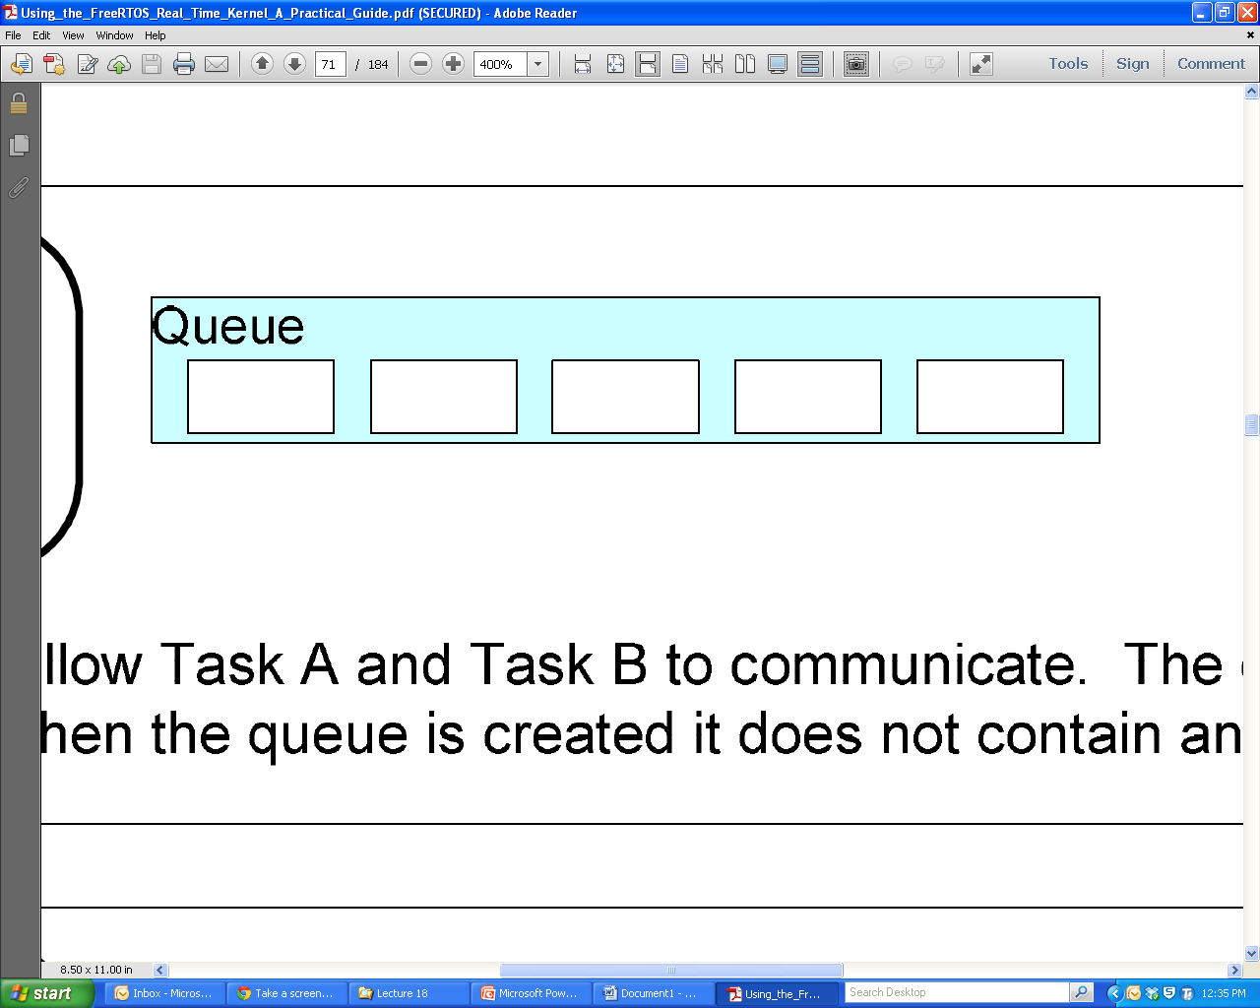
Characteristics of a Queue
A holds a finite number of fixed sized data items
The Length of a queue is the max number of items it can hold
Normally queues are First in First Out (FIFO) buffers
Out
In

Slide 56
Queues as Objects
A queue is its own object not owned by the creator of the task
Multiple writers and readers of the queue are possible
A queue having multiple writers is common, multiple readers is rare.

Slide 57
Blocking on Queue Reads and Writes
If a task wants to read from the queue but the data has not been written yet, the task can block itself until the queue has been written to.
If a task wants to write to the queue but the queue’s length has been reached then a task can block itself waiting for a queue read by another task to occur.
In both cases a task can specify a max amount of time to wait.
Notes:
Multiple readers or writers can be waiting for a read or write to occur only the highest priority task will be unblocked when that occurs. If at the same priority the one that has been waiting the longest will be unblocked.

Slide 58
Binary Semaphore
Can be used to unblock a task each time a particular interrupt occurs. If the unblocked task is of high priority it will run immediately.
This allows the ISR to be very short but still trigger a task very quickly after the event has occurred.
The interrupt processing is said to have been ‘deferred’ to a ‘handler’ task.

Slide 59
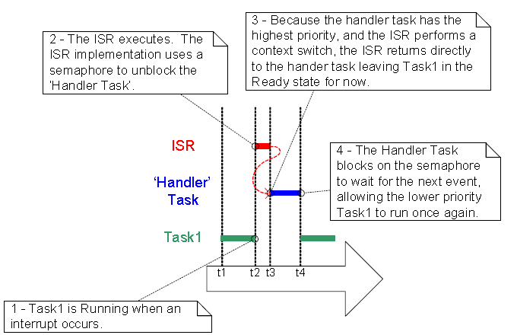
Using Interrupt to Preemptively Change Tasks

Slide 60
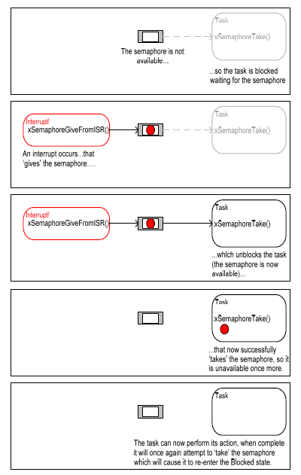
Example of a Semaphore
Think like a queue of length = 1 (binary)
To Give is to put a ‘value’ into the queue
To Take is read a ‘value’ from the queue

Slide 61
Counting Semaphores
A counting semaphore can take a number of ‘gives’ before a ‘take’ occurs
What happens if interrupts can occur at high frequency over a short period of time?
Counting Semaphore can be thought of a queue of n elements
A binary semaphore might get overrun as seen in the next slide

Slide 62
Problems in Data Acquisition
Sampling will always cause some sampling error
Sampling will always cause loss of frequency content. If we sample at rate of X Hz then we can only have a frequency content up to X/2 Hz.
0111 1000
True Analog Value
Sampling error
0111 0111

Slide 63
A Data Acquisition System
When converting an analog signal to digital form, it is usually not enough just to find a suitable ADC (Analog to Digital Converter). Usually, more than one input is required and the signal needs processing before it can be converted. In most cases, therefore, it is necessary to build up a complete data acquisition system. The elements of such a system are shown below. This shows, in block diagram form, a system with multiple inputs, amplification, filtering, source selection, sample and hold, and finally the ADC itself. The different elements are outlined in the sections which follow.
Filter
Multiplexer
Removes unwanted
Selects which
ADC
signal components,
input channel is
Converts its
Voltage
Transducer
usually for
anti-
connected to its
Analog
Input to a
Generates signal
aliasing
purposes
output
Sample & Hold
Digital Output
Reference
Samples its input
signal, and holds
that voltage as a
steady value at its
output
Sample
Digital
Output
Amplify and Offset
Input Select
Start
Output
Amplifies signal and
Conversion
Result
CPU
adds DC offset, to
Conversion
Control
match ADC input
Complete
range.

Slide 64
The Sample and Hold Circuit
Because most ADCs work better converting a stationary voltage, a Sample and Hold circuit is commonly used. In this type of circuit a capacitor is charged from a source which inevitably has some resistance. Further resistance comes from internal resistance of the solid-state switch used in the S&H, and/or in the multiplexer. Therefore the capacitor takes finite time to charge, with a charging characteristic as shown.
A Simple Form of Sample and Hold Circuit
Charging Characteristic of Sample & Hold
Notes:
So how close to Vs must you get, lets say to ½ bit. So an 8 bit converter is 1/255* 1/2 = .196% or X = .9980. This gives a t of RC 6.238

Slide 65
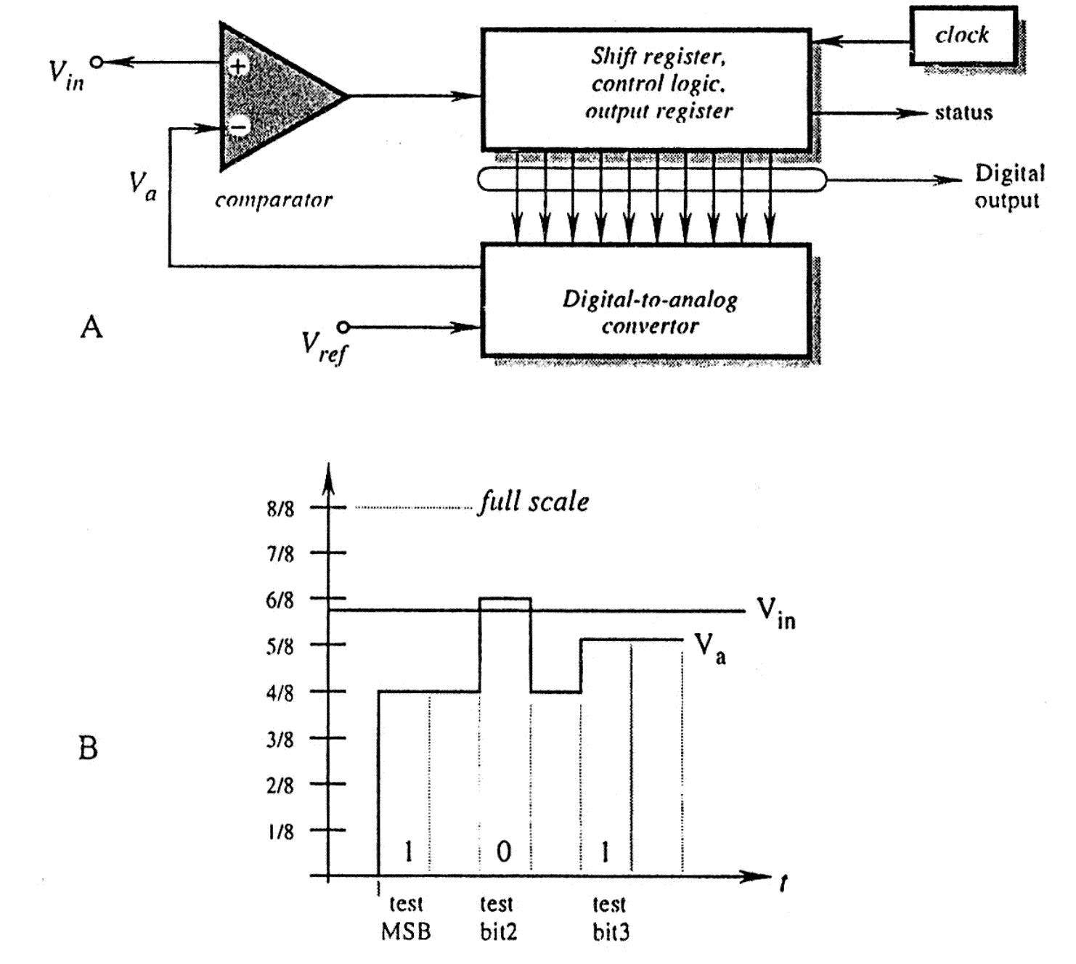
Successive Approximation A/D
Notes:
This is the type of A/D convertor in the dsPIC

Slide 66
The Analog to Digital Converter (ADC)
The ADC accepts an input voltage that is infinitely variable, and converts this to one of a fixed number of output values. An example ADC conversion characteristic is shown, where the input voltage is represented on the horizontal axis, and digital output on the vertical.
For an n-bit ADC, the maximum output value will be (2^{n} – 1). For example, for an 8-bit ADC, the maximum value will be (2⁸ – 1), or (256 – 1), i.e. 255 decimal or 11111111 binary.
Min 0 V = Code 0
Max V_{max} = Code 2^{n} – 1
Resolution = V_{max} /(2^{n} – 1)
Code = D = e/V_{max} (2^{n} – 1)
Digital
Output
n
(2 - 1)
n
(2 - 2)
100
011
010
...001
0
Analogue
0
V
max
Input
Input Range
Notes:
Notice that the change to a code will ideally happen in ½ of the interval of resolutions
Also note that the text has the resolution wrong when it states it is V/2^N

Slide 67
Location of ADC
Two choices:
Integrated in the microcontroller
Separate with some type of interface to the processor
A microcontroller is an electrical noisy place.
Remember many (10s of thousands) transistors change on every clock edge
Hard to get better than 10 bit performance
I separate ADC can be isolated on the PCB to be in a quiet zone.

Slide 68
Typical Timing Requirement of one A to D Conversion
Configure & enable ADC
Select
Multiplexer
input
These stages merge
if
multiplexer
forms
“Sample” Input Signal
part of S&H
Delay for signal acquisition
“Hold” Input Signal
Start Conversion
Delay for conversion
to complete
Read Data

Slide 69
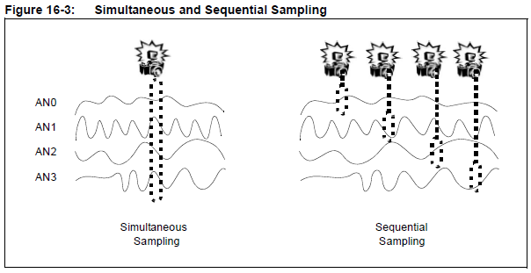
Sampling Mode
Up to 4 channels can be sampled simultaneously
Simultaneous sampling can be important in control and power calculations.
Notes:
You can configure how many sample and hold channels are going to be active for any mode. Choices are:
CH0 Only or
CH0, and CH1 or
CH0, CH1, CH2, and CH3
Remember in 12 bit mode there is only one sample and hold

Slide 70
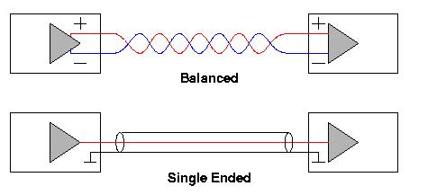
Differential Vs Single Ended
If the signal you want to read is referenced to a common ground then single ended is possible

Slide 71
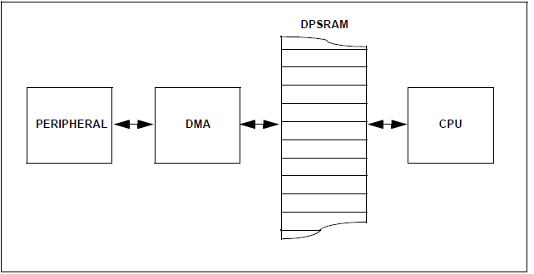
dsPIC33 DMA Structure
Dual Port Static Random Access Memory – prevents bus contention between CPU and DMA peripheral. No cycle stealing needed.
Notes:
The only situation dual port RAM can not handle is when both DMA controller and CPU try to write to the same address. If this occurs a trap is executed, so recovery can be implemented.

Slide 72
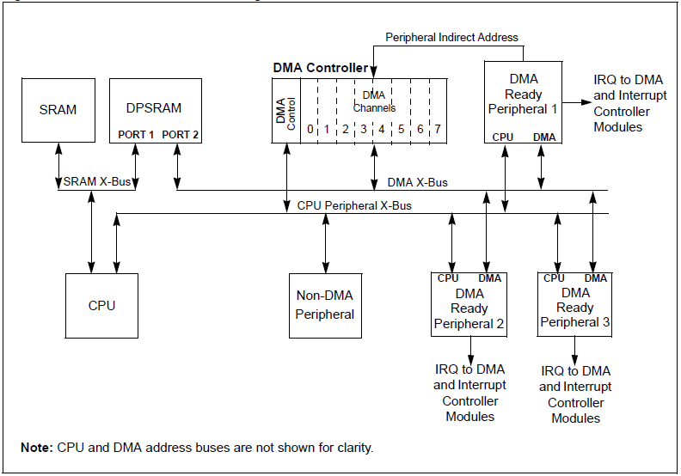
dsPIC33 DMA Block Diagram
Interrupt is DMA Request
One transfer per inst. cycle
Normal Address
Notes:
Make sure to NOT enable the interrupt that will be used to alert the DMA controller to action.

